Slide 1

Capstone Project

Slide 2



Personal BACKGROUND
(Name, Past Experience, Qualification, Career Summary)
Name : Mikkalya N S
Past Experience : Fresher
Qualification : BE – Computer Science And Engineering
Career Summary:
I've recently started working at Ascendion as a backend developer, where I am committed to lifelong learning and professional growth to enhance my technical proficiency and contribute to the company's success.
www.collaberadigital.com

Slide 3


Key Takeaways/Learnings from the Program (HTD)
Gained knowledge of LTS versions of Java.
Acquired proficiency in writing JUnit tests.
Learned to develop loosely coupled applications within a monolithic architecture.
Migrated monolithic architecture to microservices using REST API, Spring Boot, with a focus on reliability and Bean Creation.
Gained understanding of Eureka Server for scaling microservice instances, service discovery, and tracking running servers.
Deployed Eureka Server and microservice instances on AWS using EC2.
Learned about NFS (Network File System) and WFS (Windows File System).
Gained knowledge of the Creational Builder Pattern for constructors.
Explored interface-based architecture.
Learned about Spring Cloud Config Server.

Slide 4

Problem Statement of the Air Transport System Project
Objective:
Develop a secure, scalable and reliable Air Transport System (ATS) using microservices with Spring and Spring Boot Framework to improve the management of planes, airports and bookings.
Key Features:
-> Microservice Architecture -> Loosely Coupled architecture -> Reliable -> Scalable

Slide 5
Air Transport System – Microservice Architecture
Set up the ATSDB database.
Develop an Admin Microservice for user registration.
Implement a Login Microservice for user authentication.
Build a Plane Microservice to manage plane details (create, read, update, delete).
Create an Airport Microservice to handle airport information (create, read, update, delete).
Design a Booking Microservice for managing booking records (create, read, update, delete).
Create database tables for user_credentials, plane, airport, and booking.
Test all microservices using Postman.
Deploy all microservice instances on the Eureka server.
Develop a Feign client to link the Login and Booking microservices, ensuring bookings are displayed to users upon successful login.
Create an Entity-Relationship Diagram (ERD) for the database tables.
Report progress regularly in Jira.

Slide 6
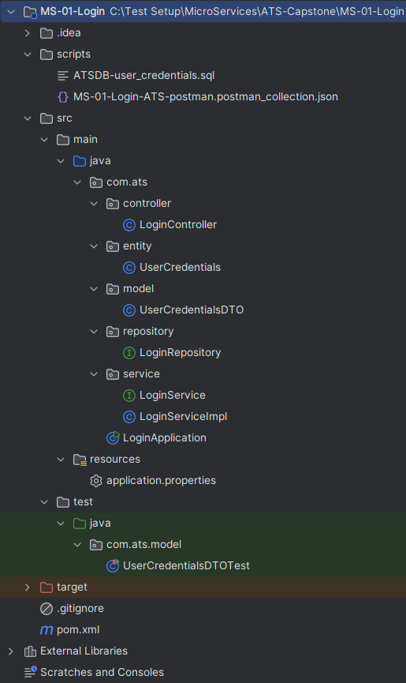
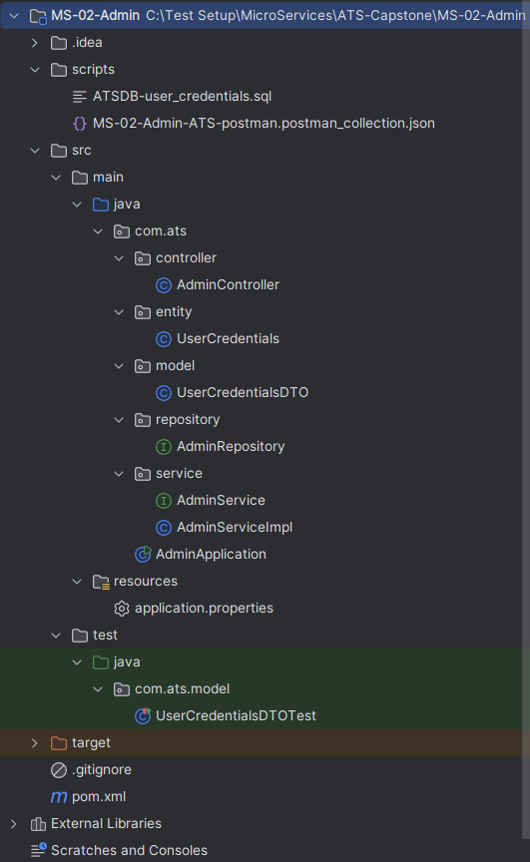
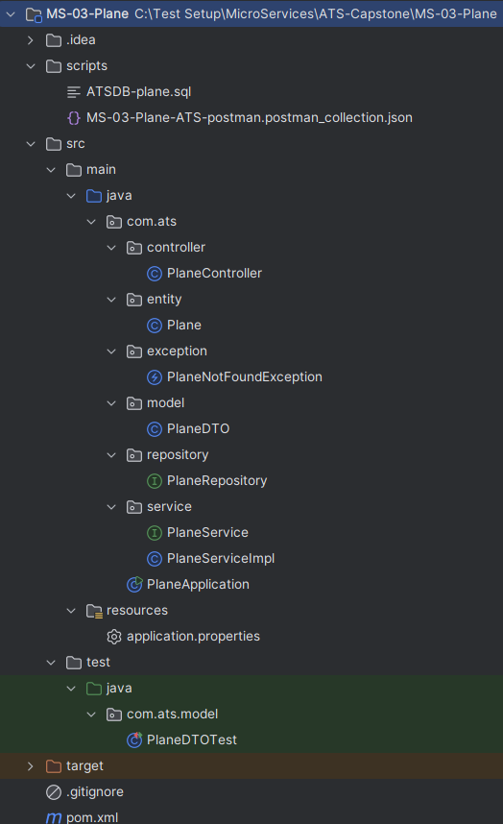
Structure of Login, Admin, Plane Microservice

Slide 7
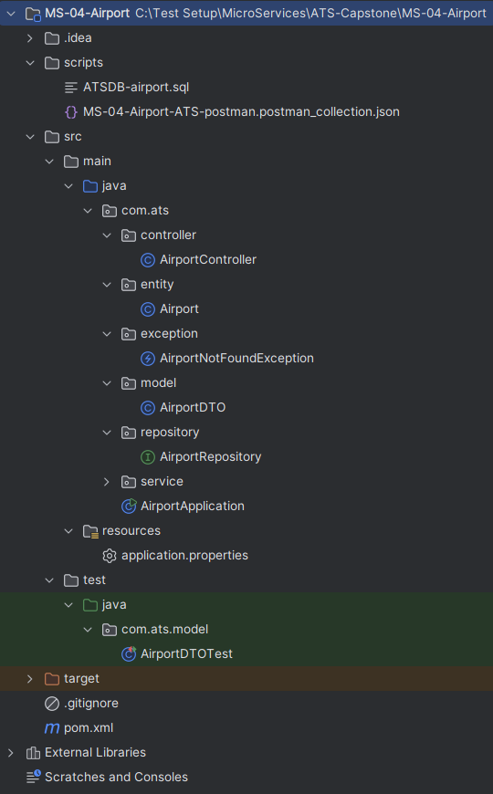
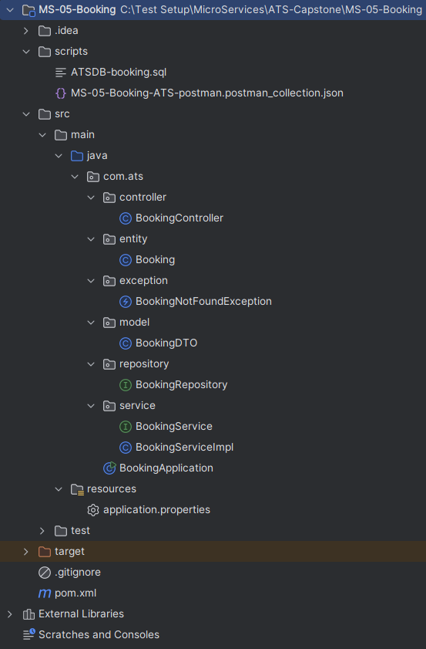
Structure of Airport, Booking Microservice

Slide 8
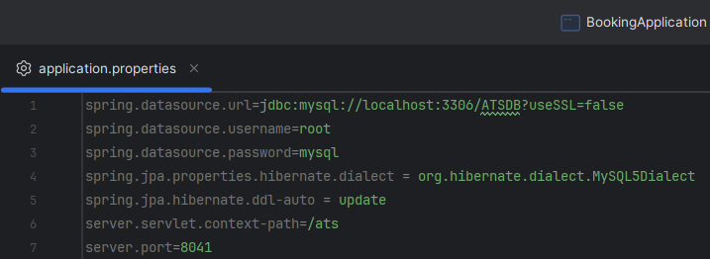
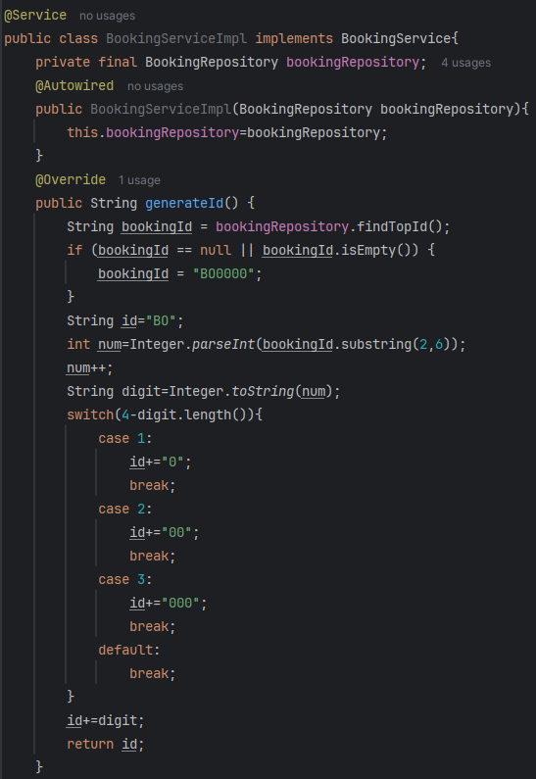
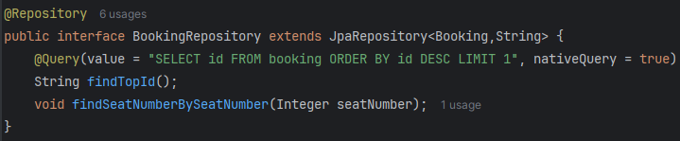
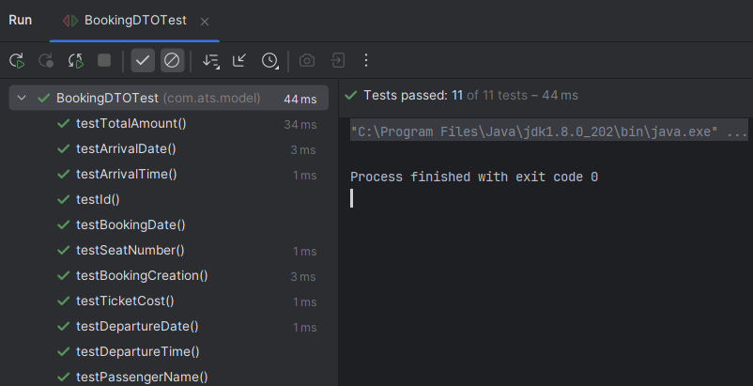
Booking Microservice – Repository, Service, Junit, application.properties

Slide 9
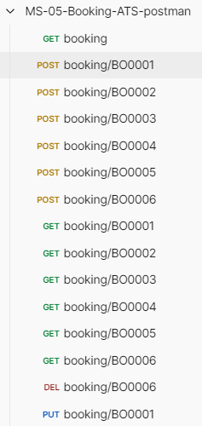
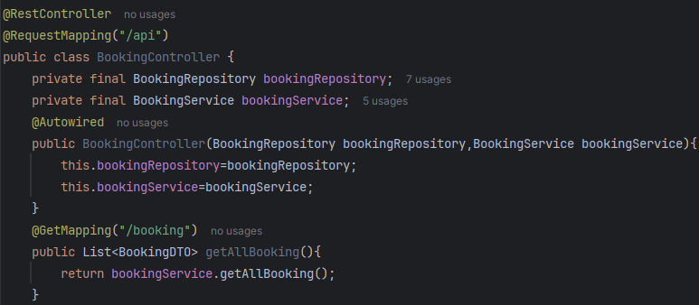
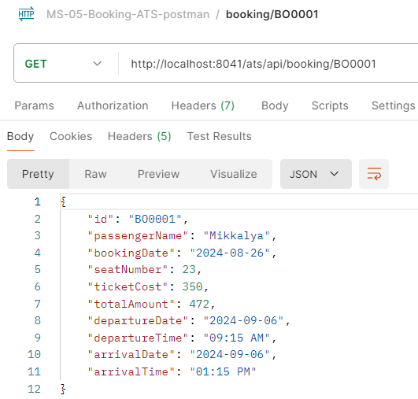
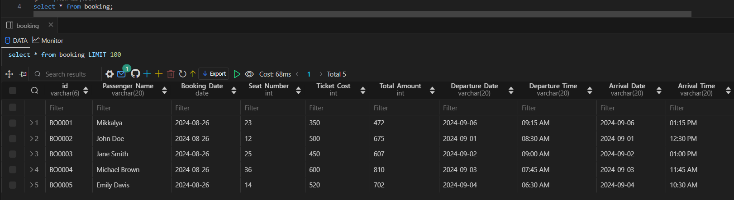
Booking Microservice – Controller, Database, Postman

Slide 10
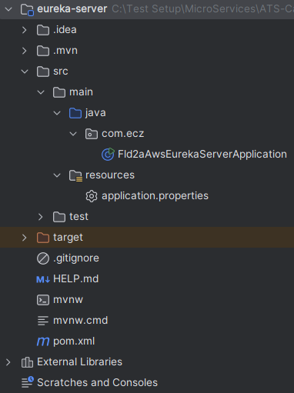
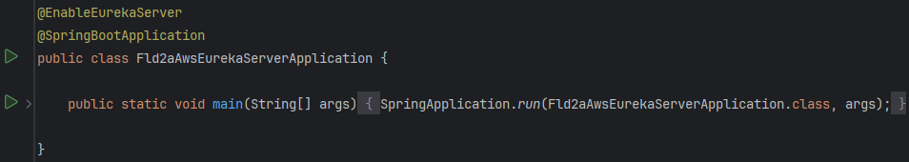
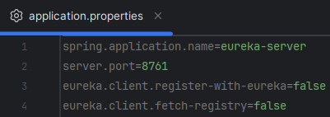
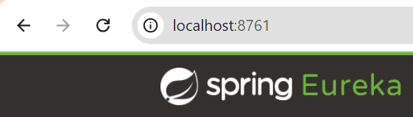
Eureka Server – application.properties

Slide 11
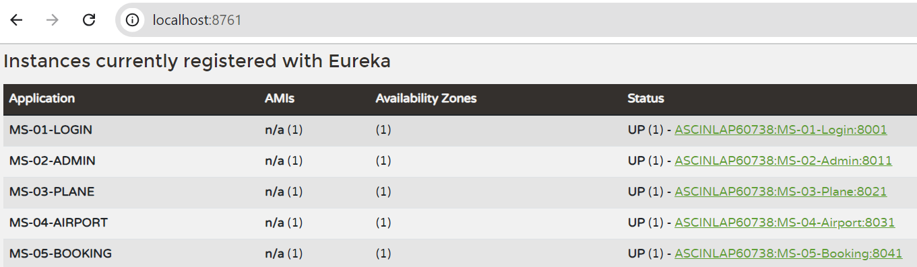
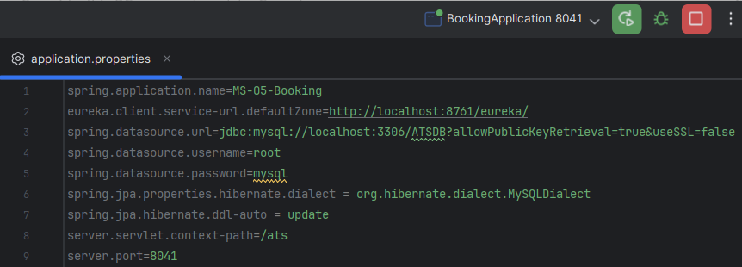
Eureka Server – Instance of All Microservices

Slide 12
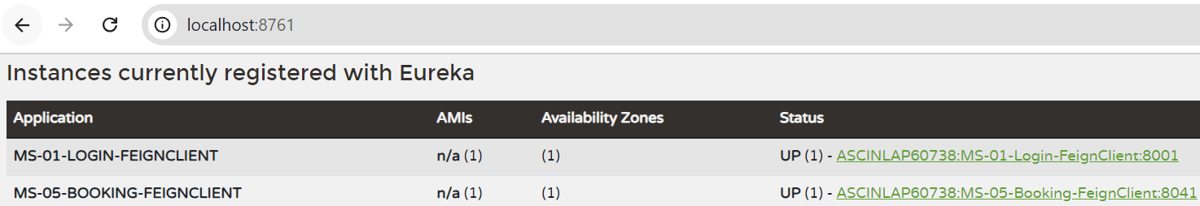
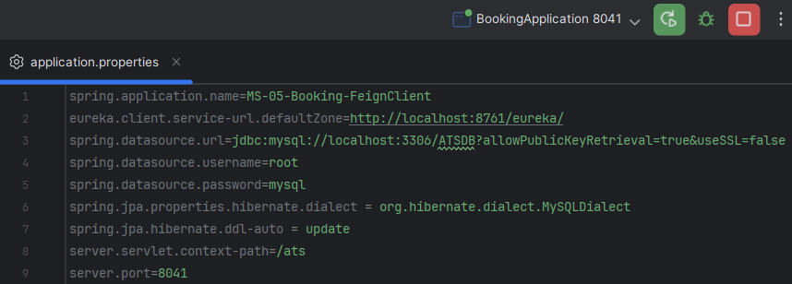
Feign Client – Instance Of Login and Booking Microservice in Eureka Server

Slide 13
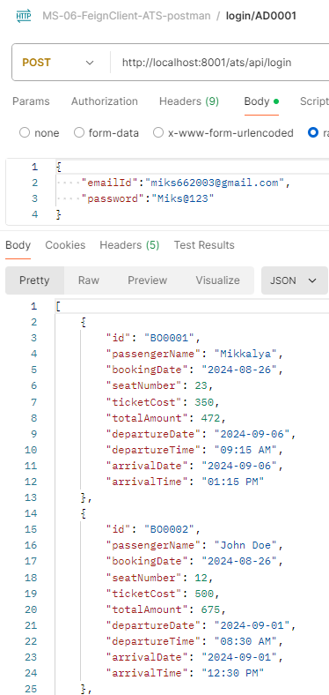
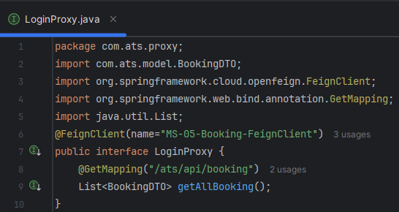
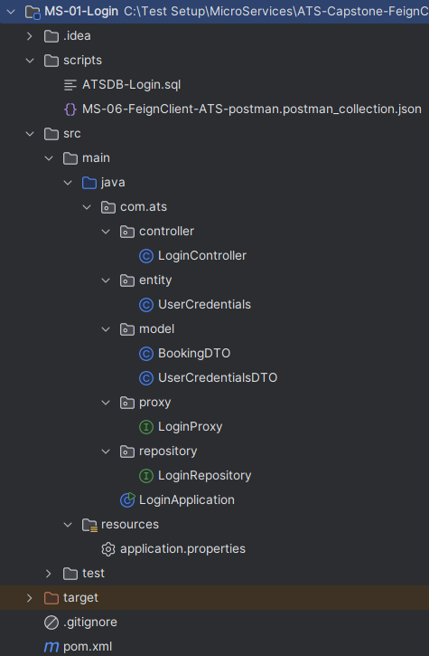
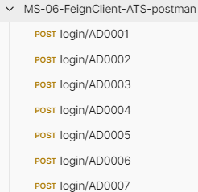
Feign Client – Connecting Login and Booking Microservice
When Login Successful, display all booking details to user who is login.

Slide 14
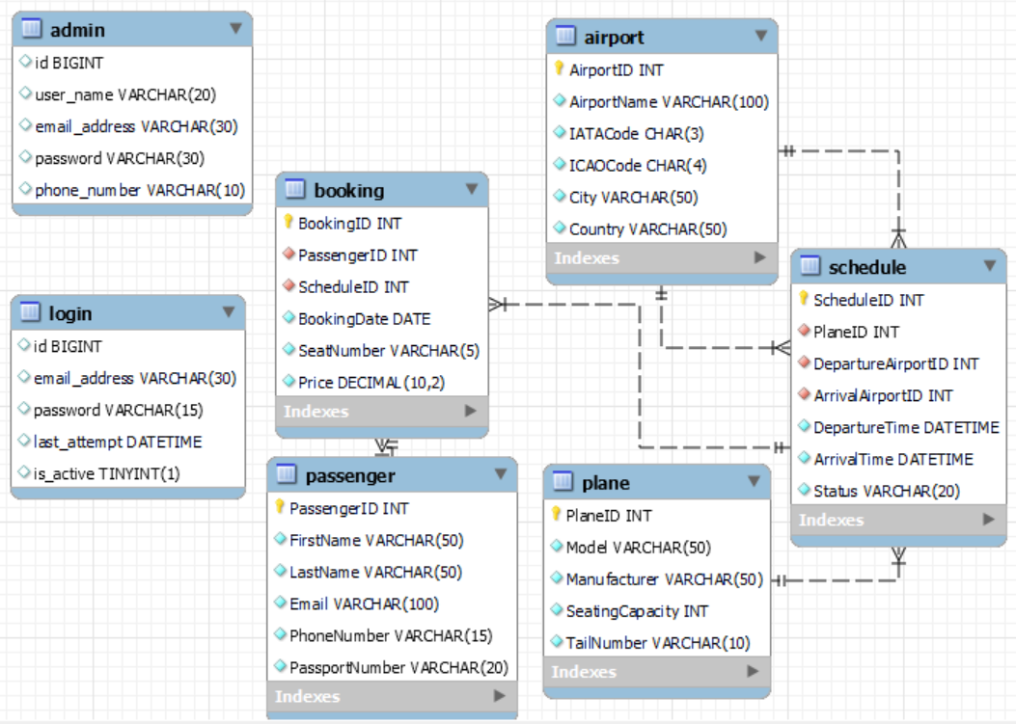
Entity-Relationship Diagram

Slide 15
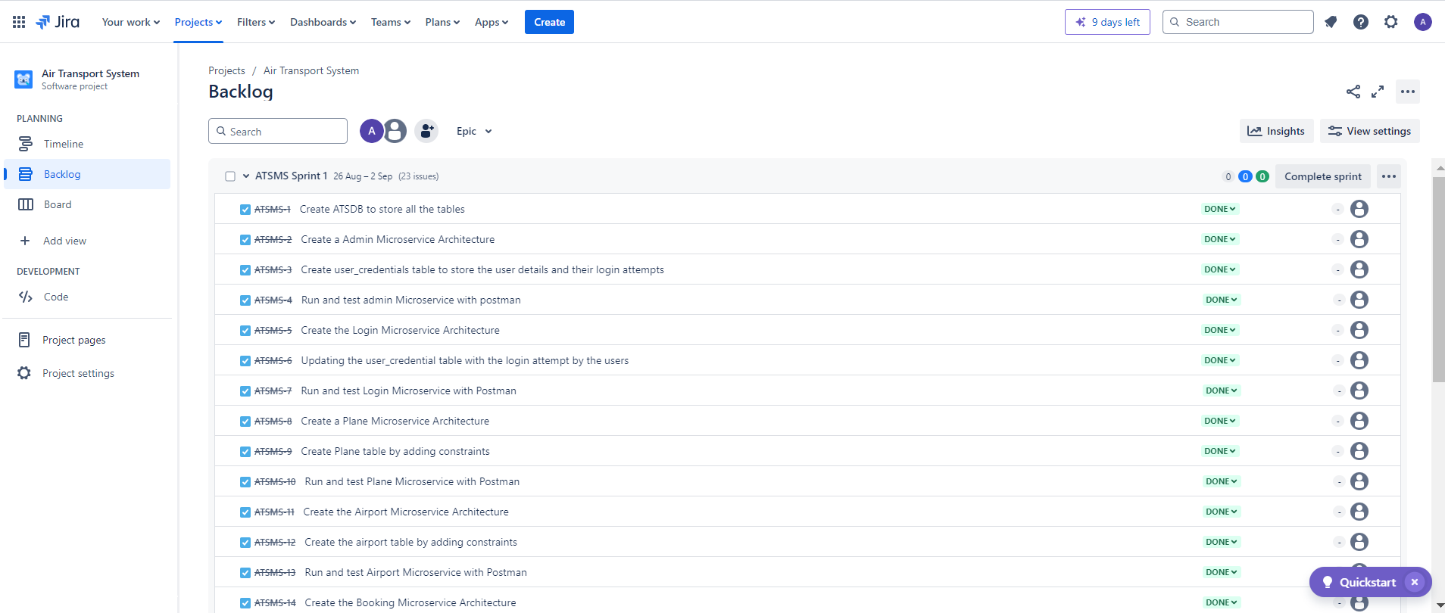
JIRA – Air Transport System - Sprint

Slide 16
Conclusion
The program enabled me to gain hands-on experience with Java LTS, JUnit testing, and transitioning from monolithic to microservice architectures using Spring Boot and AWS, focusing on reliability and scalability.
I also learned key concepts like Eureka Server, NFS/WFS, Creational Builder Pattern, and interface-based architecture, while effectively managing and deploying microservices in a cloud environment.
These skills were applied in the ATS project, where I successfully designed, implemented, and tested various microservices, ensuring seamless integration and reporting progress through Jira.

Slide 17
Thank You

